Slide 1
Large scale SAR analysis: Activity landscapes
Presented by:
Zenitha S

Slide 2
Introduction
Computational methods for SAR analysis:
QSAR: Quantitative structure activity relationship
Large scale SAR-analysis
Standard QSAR relies on the paradigm of linearity between structure and activity relationships.
Notes:
Different computational methods for SAR analysis exist

Slide 3
Introduction: SAR continuity and discontinuity
SAR continuity: This means that small chemical changes (e.g. R-group replacements) should be accompanied by small (predictable) changes in potency.
SAR discontinuity: Small structural changes should be accompanied by dramatic effects on bioactivity.

Slide 4
Introduction: Why prefer large scale SAR analysis over QSAR?
Limitation of QSAR modeling: SAR discontinuity falls outside the applicability domain of conventional QSAR, as it departs from the paradigm of linearity.
It should be able to account for both continuity and discontinuity.
Because SAR information must be extracted from large compound data sets (containing hundreds or thousands of active molecules), rather than individual compound series, SAR visualization in large scale SAR analysis plays a key role in this context.

Slide 5
What is an activity landscape?
An activity landscape is defined as any graphical representation that integrates similarity and potency relationships between compounds sharing the same specific activity.
The graphical representation explains the SAR information.

Slide 6
Types of activity landscape representations
Structure–Activity Similarity (SAS) maps:
2D plot
Each data point in plot corresponds to a compound pair
Compares molecular similarity and potency relationships between a compound pair.
3D activity landscape view:
2D projection of chemical reference space with third dimension as biological activity
SAR networks:
Network-like Similarity Graph (NSG)
Bipartite Matching Molecular Series Graph (BMMSG)
Notes:
: First activity landscape representation. Among activity landscape representations, molecular networks or network-like graphs have become rather popular

Slide 7
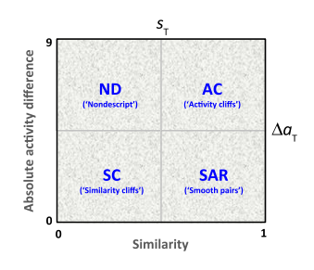
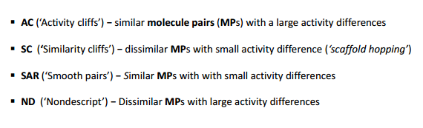
Structure–Activity Similarity (SAS) maps
http://bulletin.acscinf.org/PDFs/247nm133.pdf Accessed on 22.11.2016
Notes:
: It was the first activity landscape representation. It is a 2D plot that compare molecular similarity and potency relationships between compounds in a pair-wise manner (such that each data point in the plot corresponds to a compound pair)

Slide 8
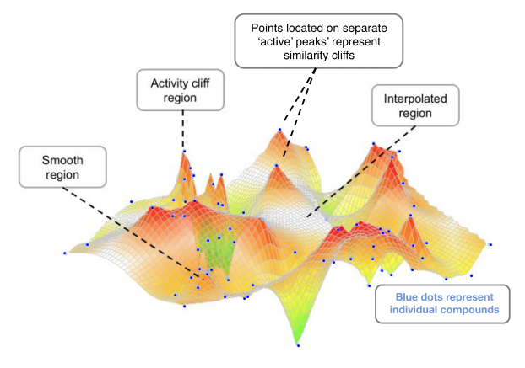
3D Landscape view
http://bulletin.acscinf.org/PDFs/247nm133.pdf Accessed on 22.11.2016

Slide 9
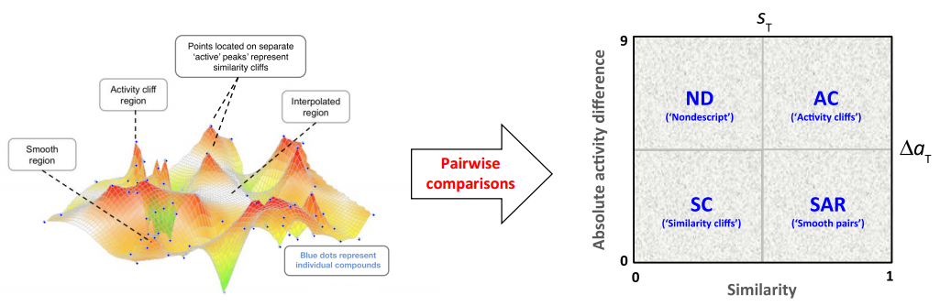
Comparing SAS map and 3D landscape view
http://bulletin.acscinf.org/PDFs/247nm133.pdf Accessed on 22.11.2016

Slide 10
Possible Questions
What is an activity landscape?
What are the types of activity landscape representations?
What is a structure activity map(SAS)?
What is a 3D landscape view?
How is a 3D landscape more informative than a SAS map?

Slide 11
Thank You

